Slide 1

How Does a Bike-Share
Navigate Speedy Success?
Case Study:
Cyclistic BIKE-SHARE
Lucjan Konopka
November 2022

Slide 2
Introduction

Slide 3
Motivation
...
The goal of the analysis:
understand how casual riders and annual members use Cyclistic bikes differently in one year period
design a new marketing strategy to convert casual riders into annual members

Slide 4
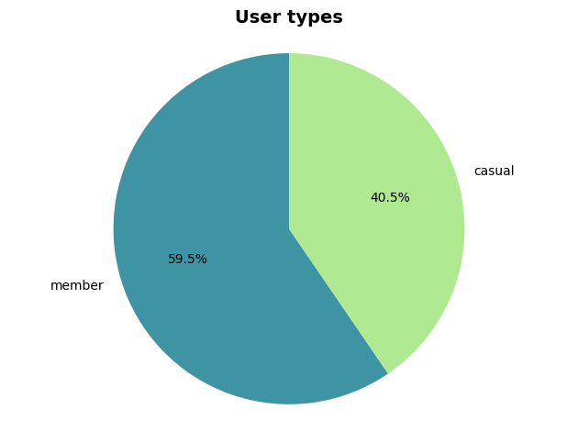
User types
Almost 60% of rides in the reviewed period were carried out by regular members. There is still huge potential to gain more members out of casual riders.

Slide 5
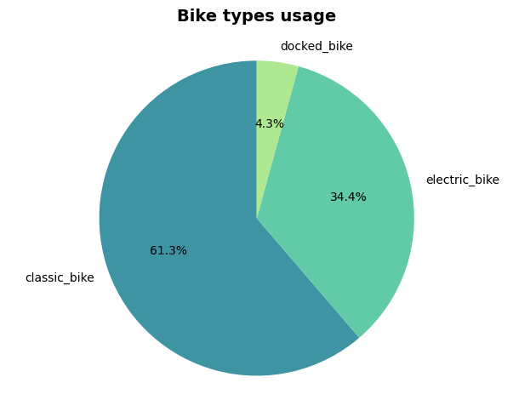
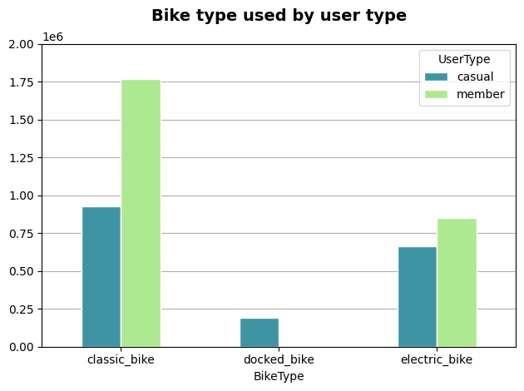
Bike types used
Most popular bike among both types of users was the classic bike. In fact, docked bikes were only used by casual riders.

Slide 6
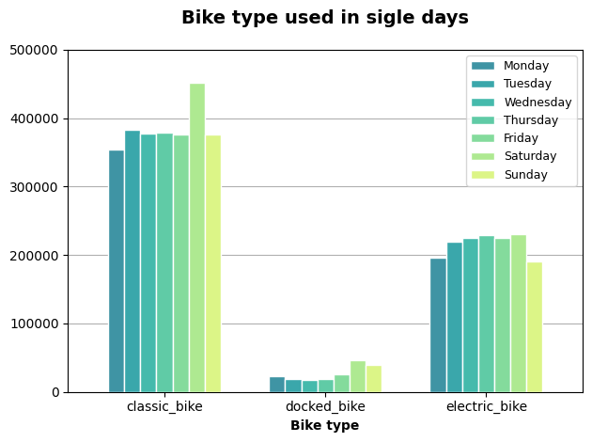
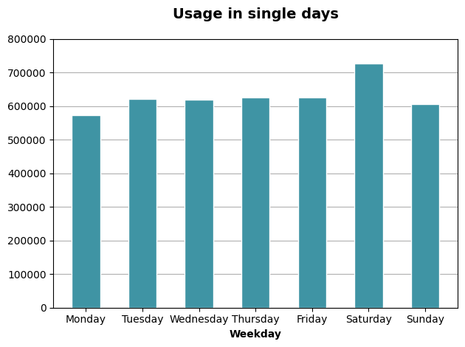
Usage in single days
Most of the riding took place on Saturday, especially when it came to the classic bikes. There is a pattern showing less bikes usage at the beginning and end of the week.

Slide 7
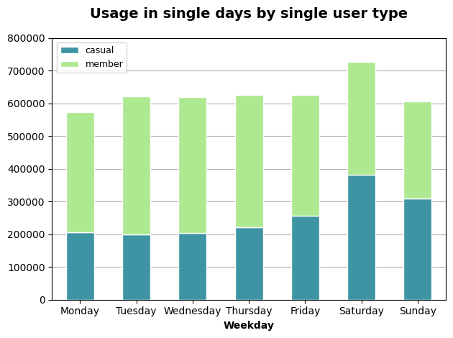
Usage in single days by single user type
The data shows a big difference in bicycle usage of casual users over a week, while annual members use bicycles more regularly.
Splitting the graph allows for a more accurate analysis…

Slide 8
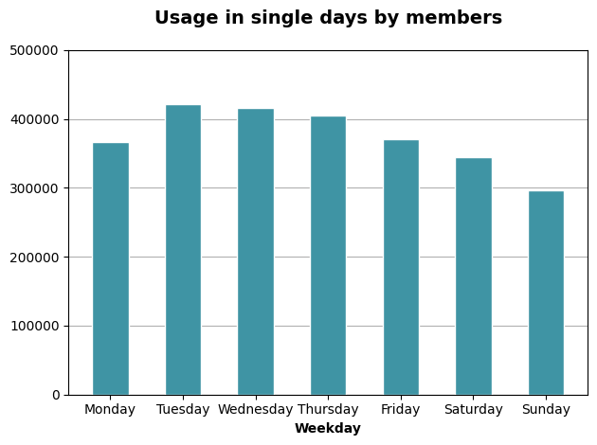
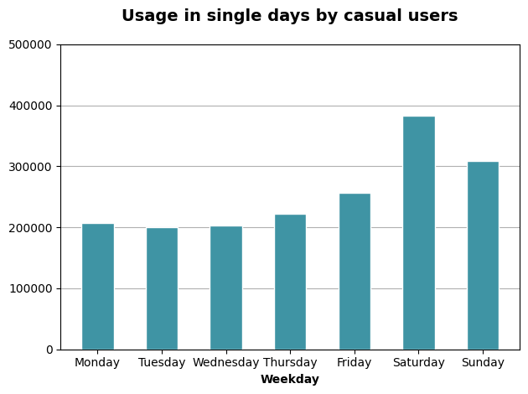
Usage in single days by single user type
Annual members used bikes more during the work week and less on weekends. The opposite relationship can be observed in case of casual users, while the closer to the end of the working week, them more bike rentals.

Slide 9
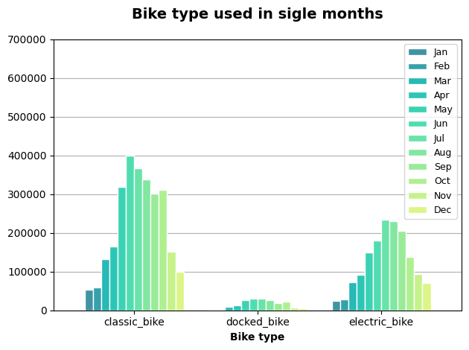
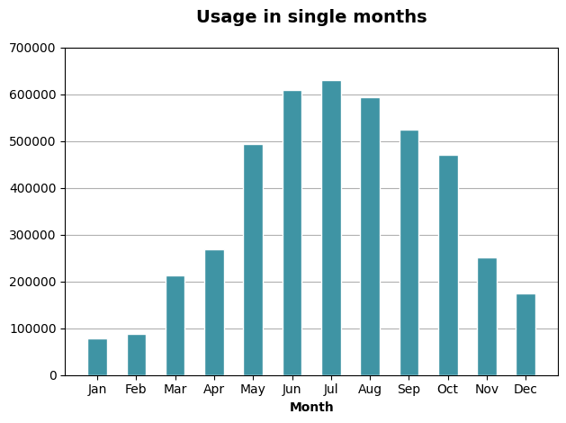
Usage in single months
The vast majority of rentals took place in the warm season from May to October.

Slide 10
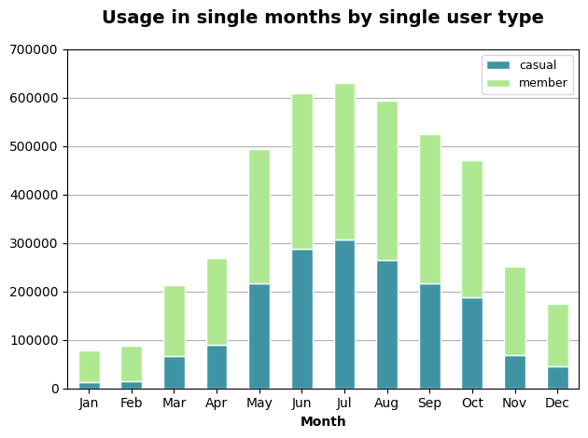
Usage in single months by single user type

Slide 11
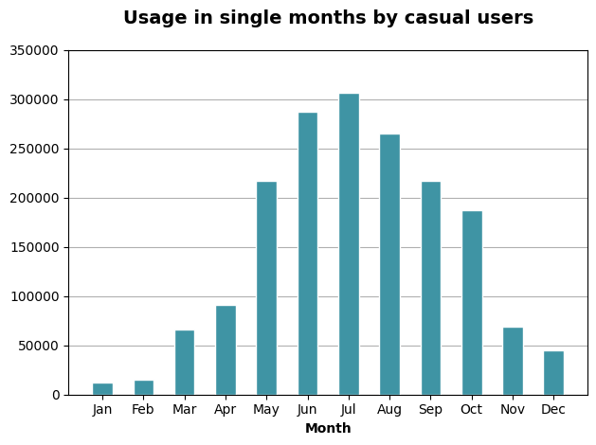
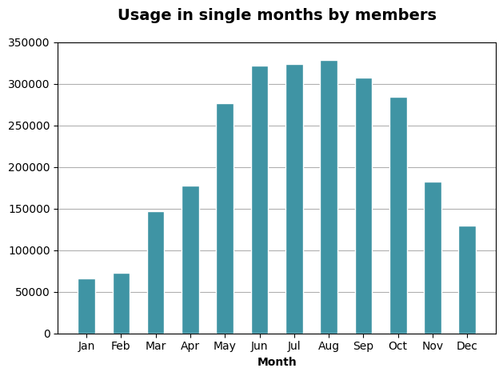
Usage in single months by single user type

Slide 12
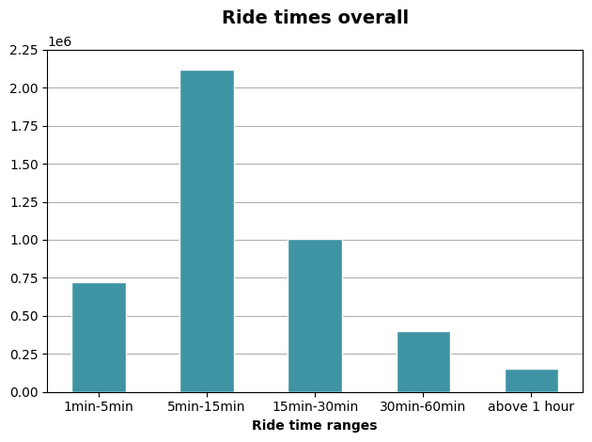
Ride times
The goal of the analysis:
understand how casual riders and annual members use Cyclistic bikes differently
design a new marketing strategy to convert casual riders into annual members

Slide 13
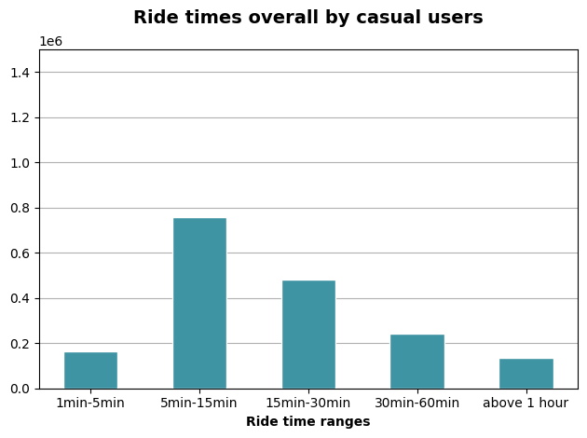
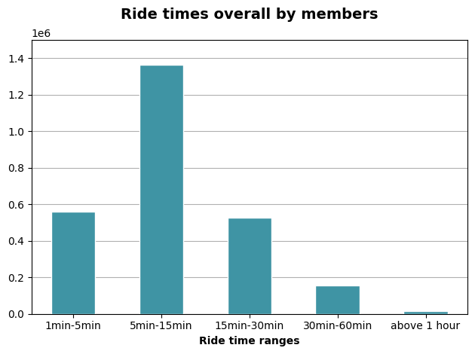
Ride times by single user type

Slide 14
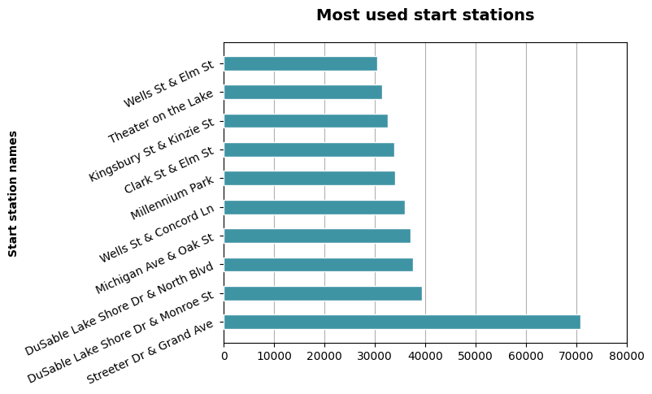
Most popular start stations

Slide 15
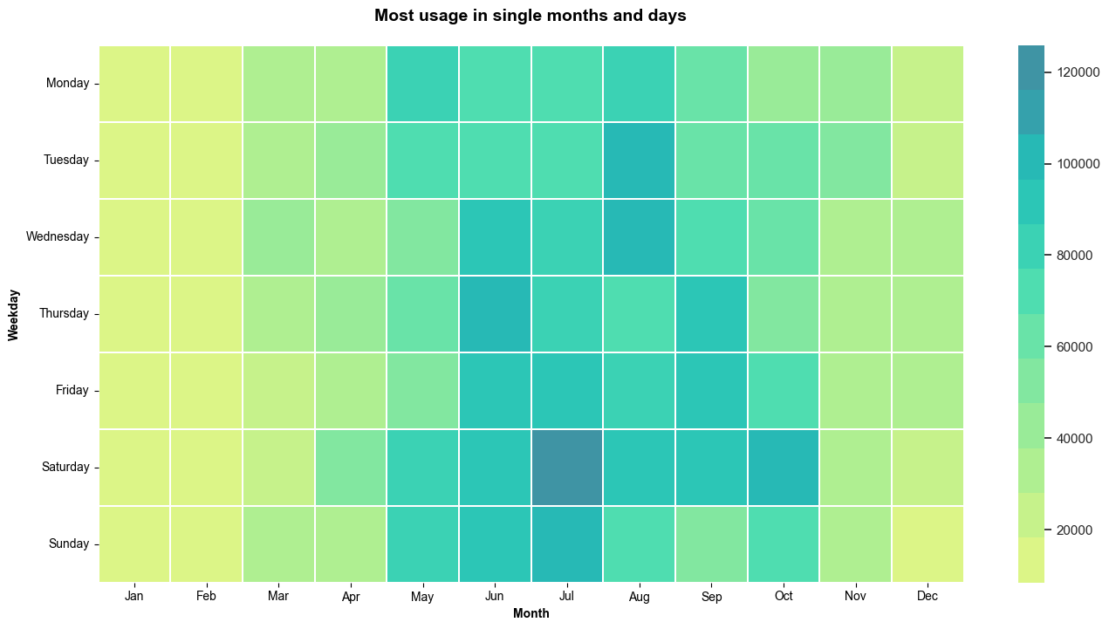
Most usage in single months and days

Slide 16
Summary??
...
The goal of the analysis:
understand how casual riders and annual members use Cyclistic bikes differently
design a new marketing strategy to convert casual riders into annual members

